Slide 1

ENGINEERING CHEMISTRY
HARISH N
9738889242
Department of Science and Humanities

Slide 2

ENGINEERING CHEMISTRY
Module 6- Electrochemical Sensors
Class Content :
BIOSENSORS
GLUCOSE SENSOR
Components of glucose biosensor
Working of glucose biosensor
Limitations

Slide 3
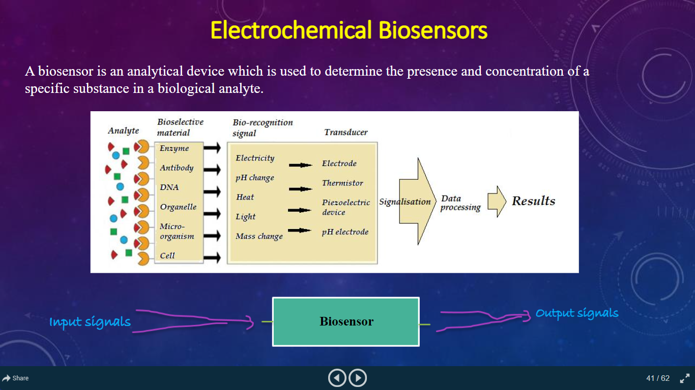
ENGINEERING CHEMISTRY
Module 6- Electrochemical Sensors
Biosensors
A biosensor is an analytical device which is used to determine the presence and concentration of a specific substance in a biological analyte.
Input Signal
BIOSENSOR
Output Signal

Slide 4
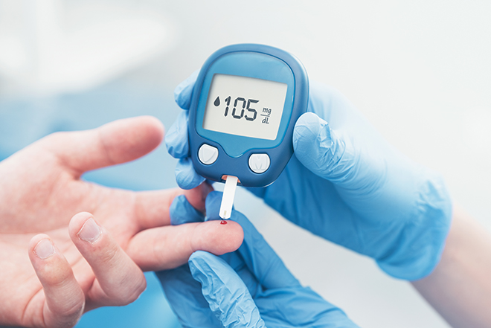
ENGINEERING CHEMISTRY Module VI- Electrochemical Sensors
Blood Glucose Monitoring
Blood Glucose Monitoring is a way of checking the concentration of glucose in the blood using a glucometer.
Provides quick response to tell if the sugar is high or low indicating a change in diet, exercise or insulin.
Over time, it reveals individual of blood glucose changes.

Slide 5
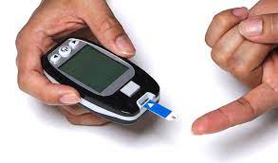
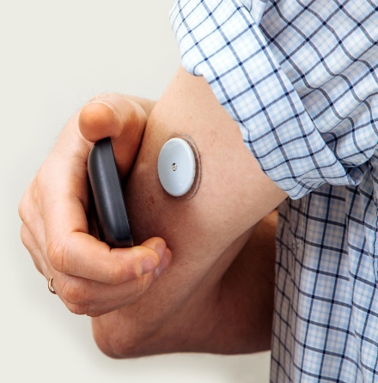
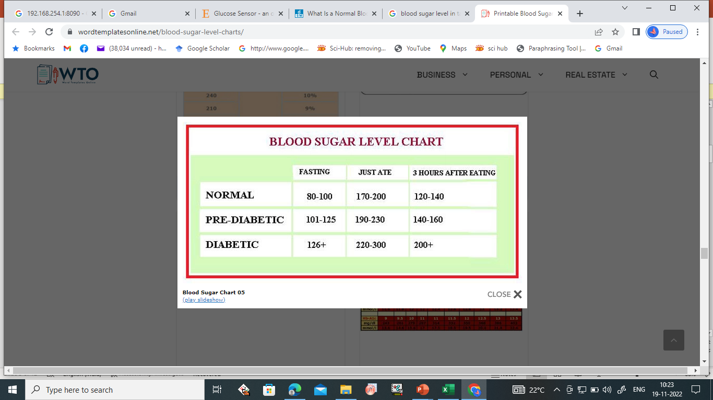
Why Monitor Blood Glucose?
ENGINEERING CHEMISTRY
Module VI- Electrochemical Sensors
Reduces risk of developing complications with diabetes.
Allows diabetics to see if the insulin and other medications they are taking are working.
Gives diabetics an idea as to how exercise and food affect their blood sugar.
May prevent hypoglycemia or hyperglycemia

Slide 6
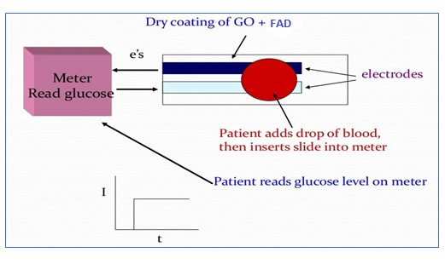
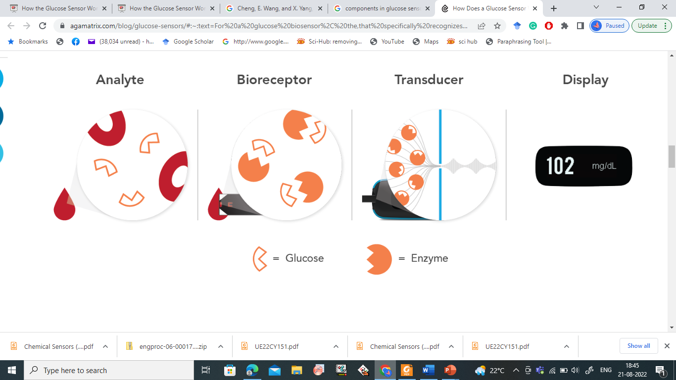
ENGINEERING CHEMISTRY
Module 6- Electrochemical Sensors
Components of Glucose Sensor
Analyte
Bioreceptor
Transducer
Electronics and display

Slide 7
ENGINEERING CHEMISTRY Module VI- Electrochemical Sensors
Working of Glucose Biosensor
Developed by Updike and Hicks
Enzyme Glucose oxidase(GOx) catalyze the oxidation of glucose by molecular oxygen producing glucolactone and hydrogen peroxide.
In order to work as a catalyst, GOx requires a redox cofactor –flavin adenine dinucleotide (FAD), works as an initial electron acceptor and is reduced to FADH₂.
Glucose + GOx –FAD⁺ → Glucolactone + GOx – FADH₂

Slide 8
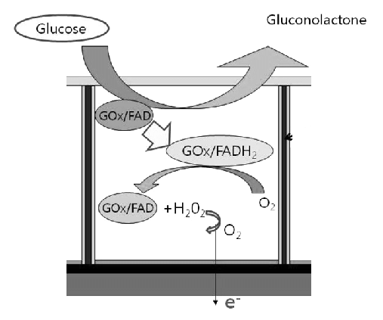
ENGINEERING CHEMISTRY
Module VI- Electrochemical Sensors
Working of Glucose Biosensor
The cofactor is regenerated by reacting with oxygen, leading to the formation of hydrogen peroxide
GOx – FADH₂ + O₂ → GOx – FAD + H₂O₂
Hydrogen peroxide is oxidized at a platinum electrode.
The number of electron transfers, at electrode surface is directly proportional to the number of glucose molecules present in the blood.
H₂O₂ → 2H⁺ +O₂ + 2e⁻

Slide 9
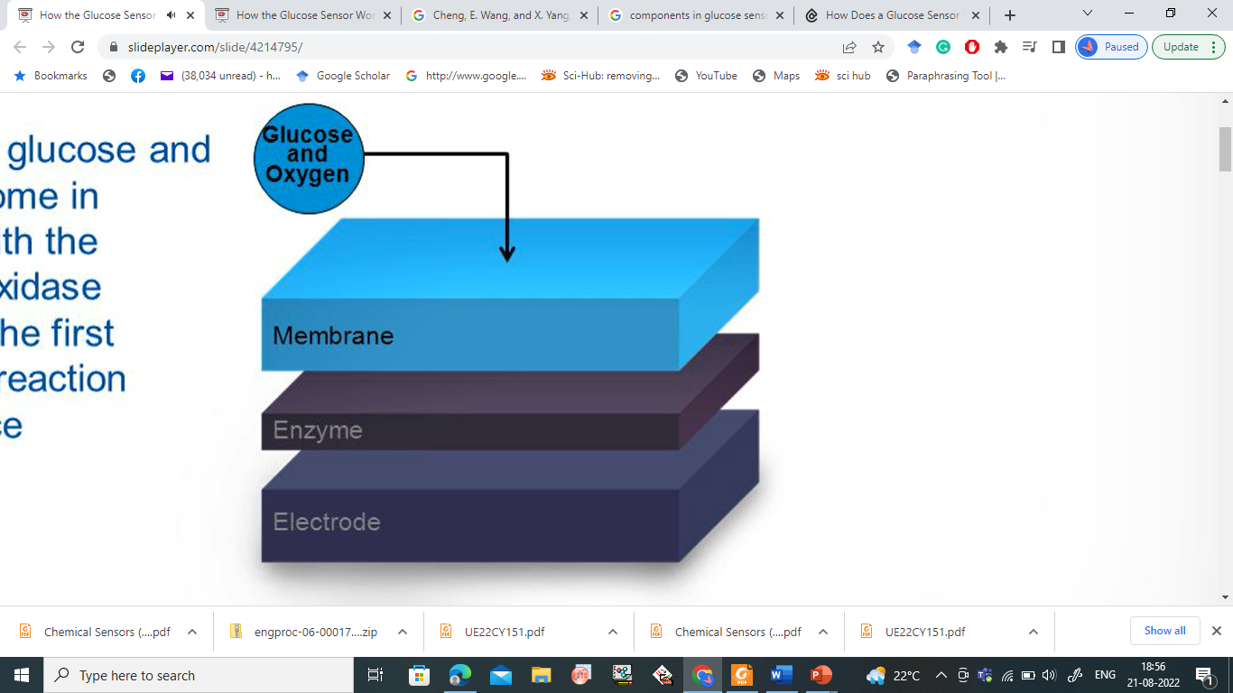
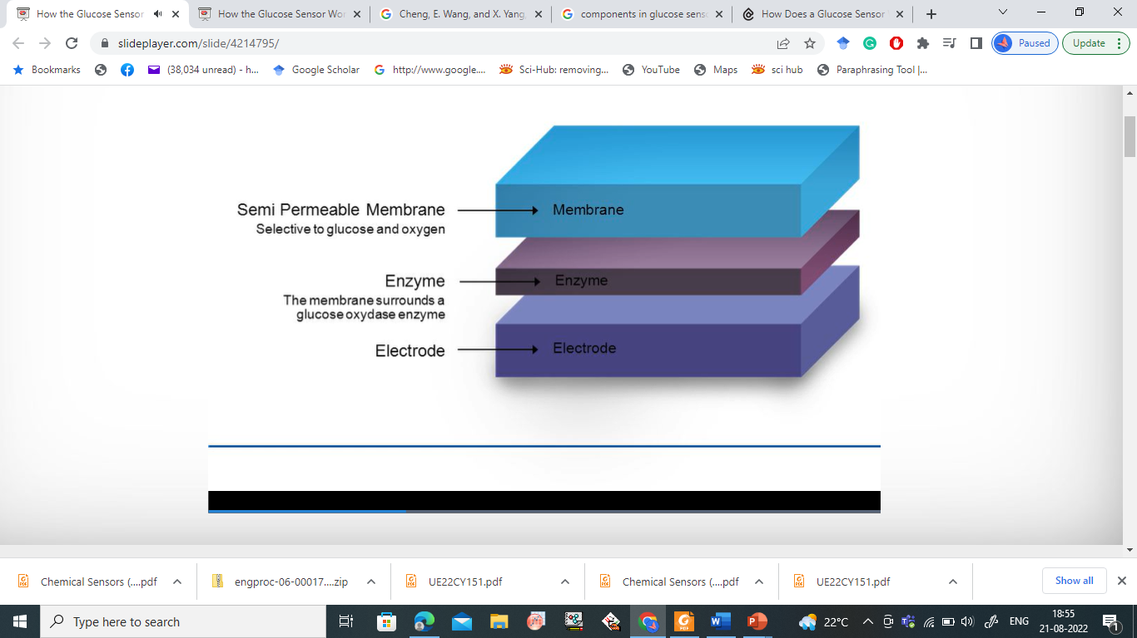
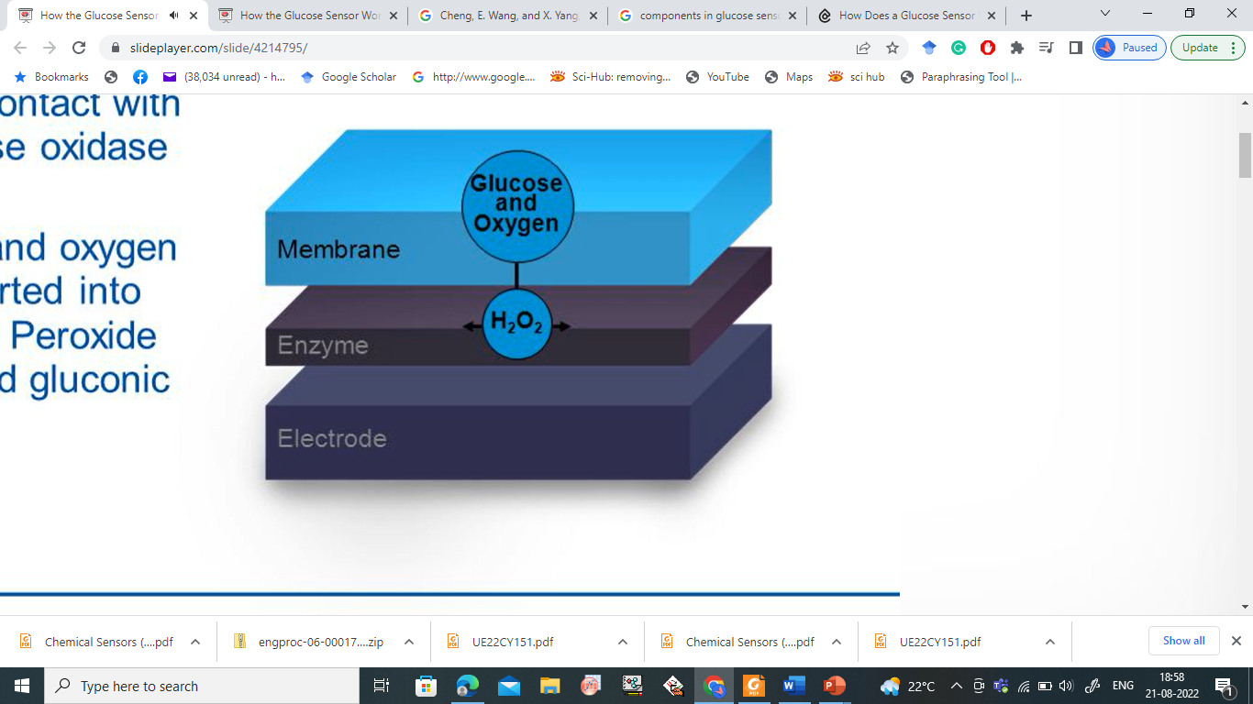
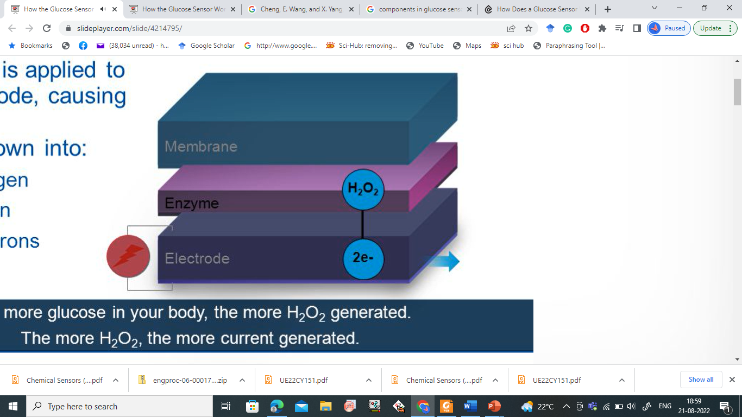
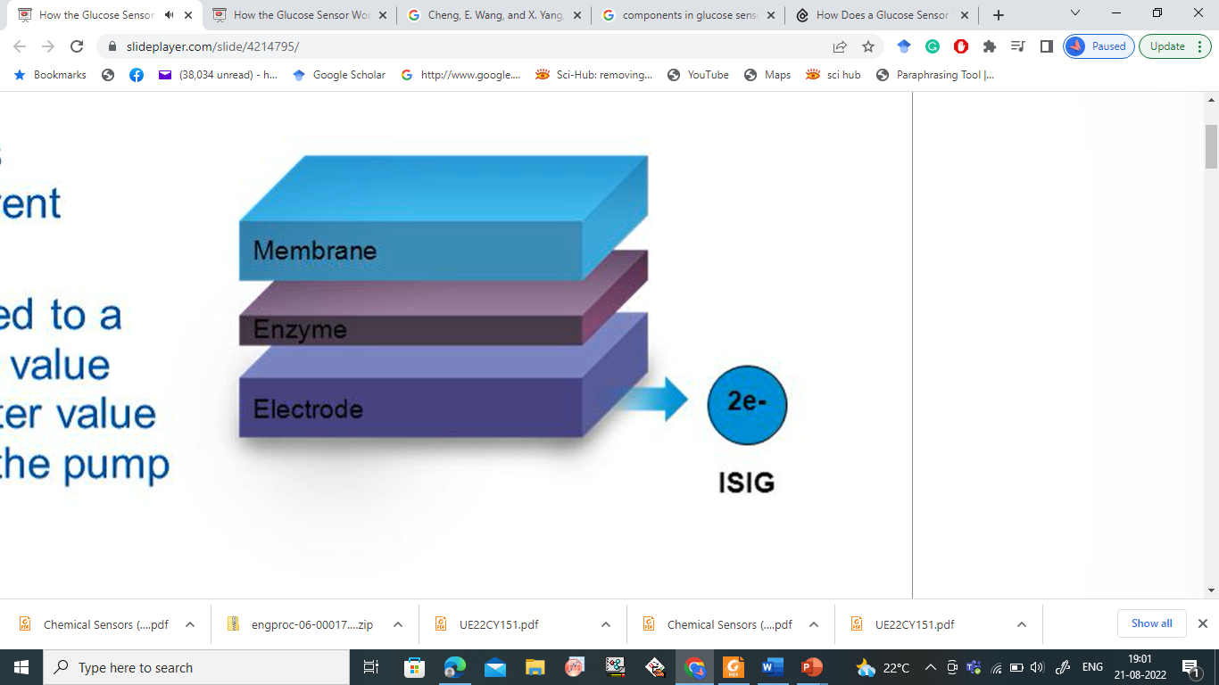
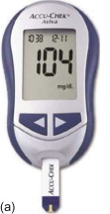
ENGINEERING CHEMISTRY
Module 6- Electrochemical Sensors
Working of Glucose Biosensor

Slide 10
ENGINEERING CHEMISTRY
Module VI- Electrochemical Sensors
Limitations of Glucose Sensors
Extreme environmental conditions like haematocrit values, or medication interferences may potentially falsify blood glucose readings.
Incorrect blood glucose readings may lead to treatment errors, for example, incorrect insulin dosing.

Slide 11
THANK YOU
HARISH N
9738889242
Department of Science and Humanities

